Slide 1
ENGI 301 “Loss Prevention Device” PCB Proposal
November 22, 2020
Spencer Wong

Slide 2
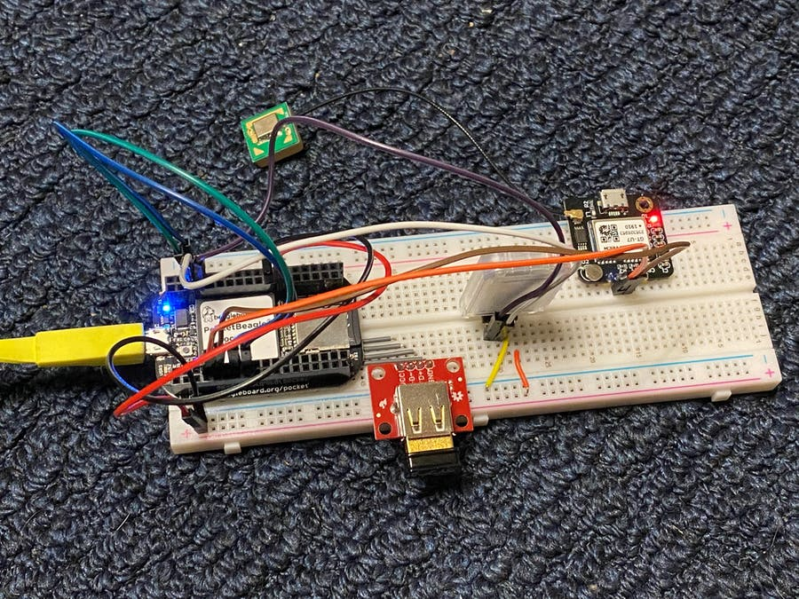
Background Information
In project 01, I prototyped a “loss prevention device”, designed around a Pocket Beagle, Bluetooth, Wi-Fi, and GPS module. This device connects to your phone, and texts your phone once it leaves the Bluetooth range. The text is customizable, but mainly includes the coordinates of the device at the time of separation. This device can be used for keeping track of children, valuables, and more.
Notes:
What is being proposed?
Pictures
Links to existing projects / libraries
What improvements / additions over existing project

Slide 3
System Block Diagram
Pocketbeagle
DSD TECH HM-10
Bluetooth
RX
Smart Phone
UART4
TX
RX
GT-U7
UART2
TX
Internet Source (probably a WiFi adapter)
USB1
MicroUsb Power Source (Car charger, battery, etc)
MicroUSB
Notes:
Create a System Block Diagram
Label interfaces / pins
Components (part numbers if possible)

Slide 4
Power Block Diagram
Pocketbeagle
5 Volts
Vout
DSD TECH HM-10
GT-U7
Internet Source (probably a WiFi adapter)
USB1
MicroUsb Power Source (Car charger, battery, etc)
MicroUSB
Notes:
Create a Power Block Diagram
Label voltages / currents of components

Slide 5
Mechanical Block Diagram
2.1”
1.38”
GPS
BT
The GPS and the USB will be on the same area as the PB, the USB port will line up with the pocket beagle USB port.
~1”
Pocket Beagle
~1.7”
2.21”
2.5”
USB/Wi-Fi
~0.8”
~0.8”
BACK
~1”
FRONT
Note: The BT module’s pins are sideways

